Slide 1
Delay is Not an Option:
Low Latency Routing in Space
Mark Handley, University College London

Slide 2
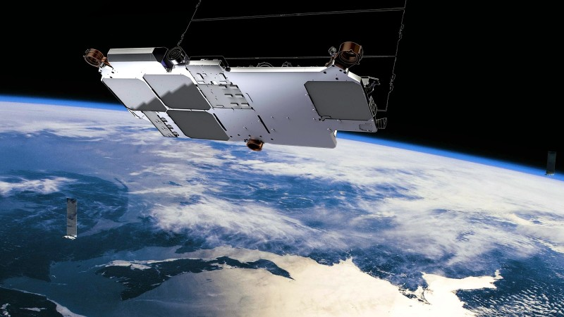
Abstract

Slide 3

Introduction

Slide 4
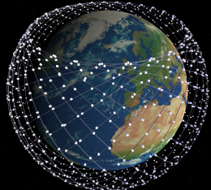
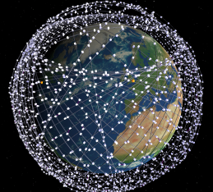
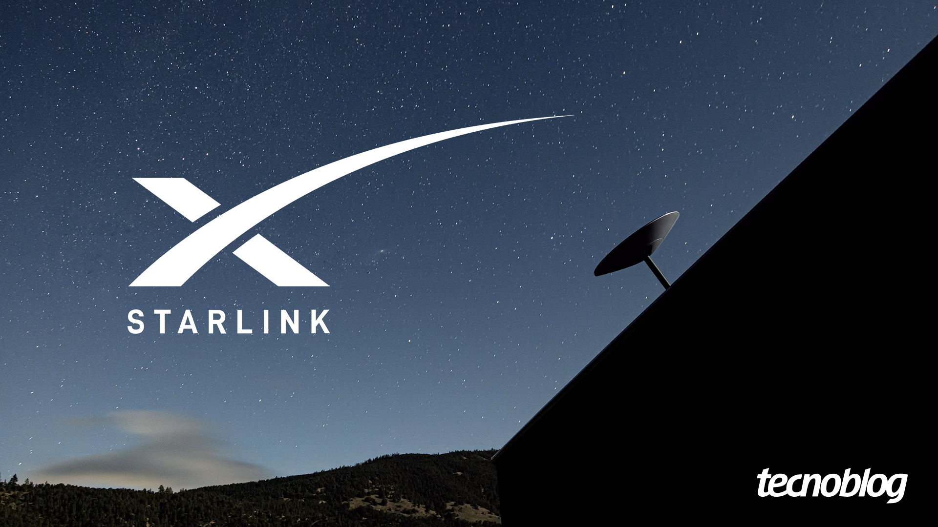
Starlink
Primeira Fase
Segunda Fase

Slide 5
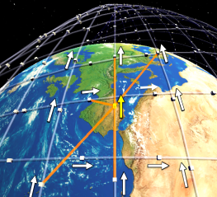
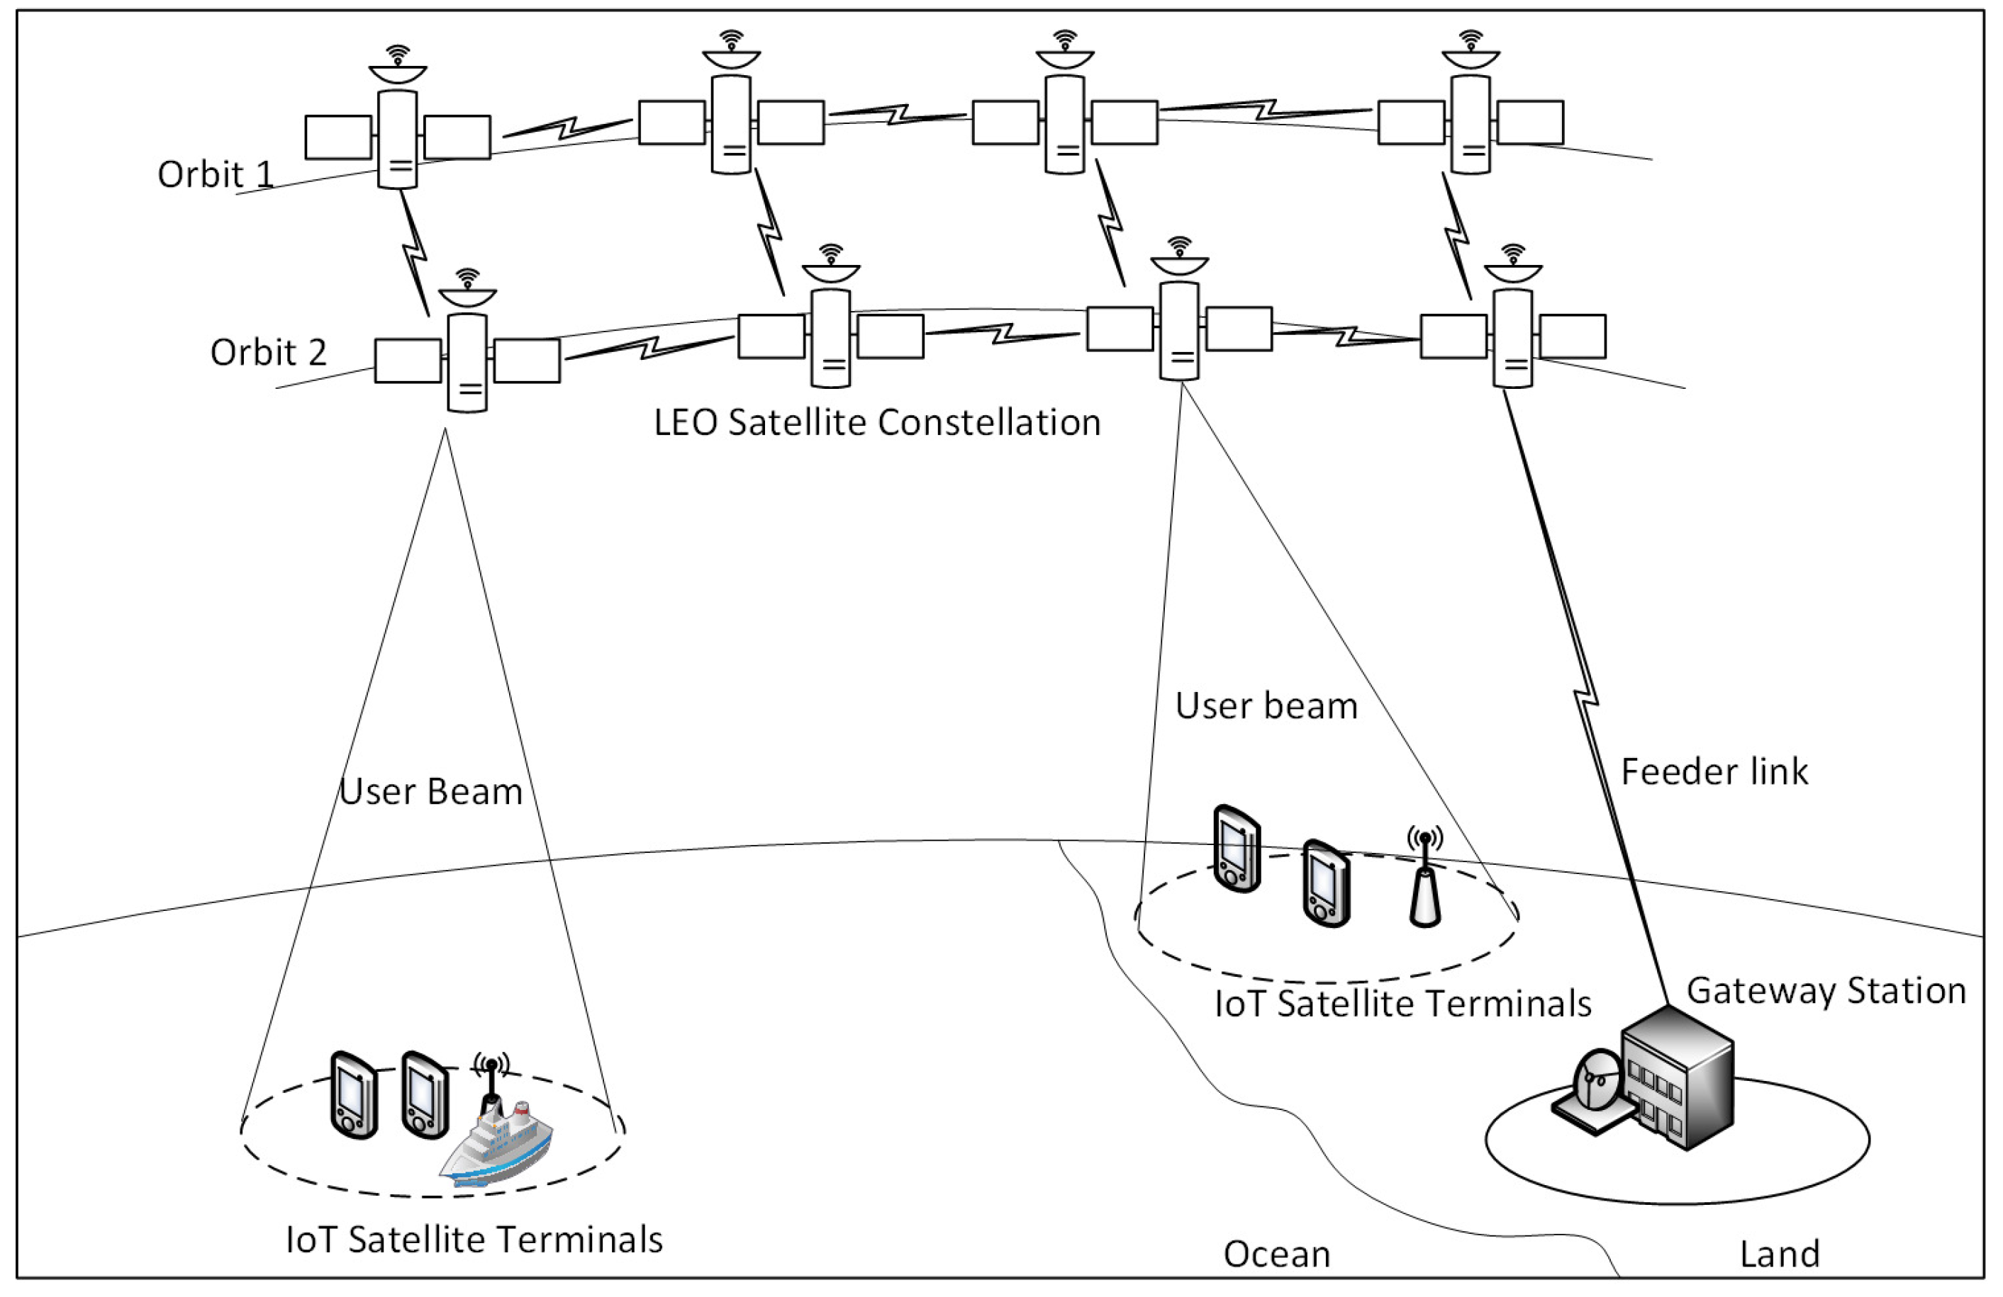
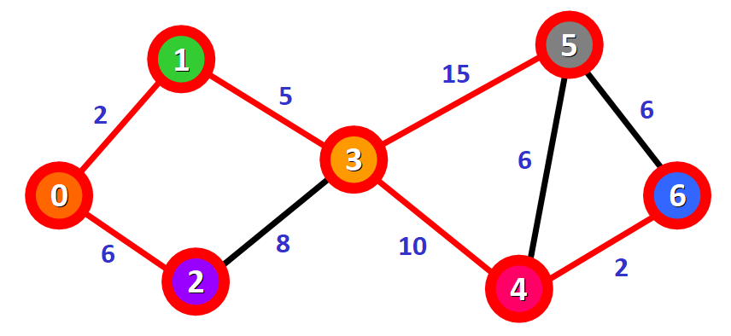
Building a Network for a LEO Constellation

Slide 6
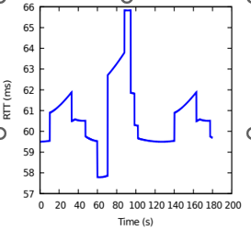
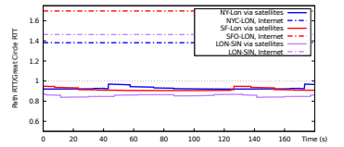
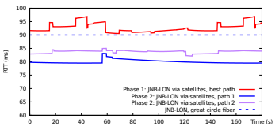
Routing
Figura 1
Figura 2
Figura 3

Slide 7

Questões Levantadas

